Slide 1

Department of ME
23ME1103
Creating list and Table in HTML
Session-3
A COMPLETE SOLUTION TO
DESIGN TOOLS WORKSHOP
K L U Students
1st year
For
EXIT

Slide 2



AIM OF THE SESSION
To familiarize students with the list and Table in HTML
INSTRUCTIONAL OBJECTIVES
This Session is designed to: Obtain knowledge of list and Table in HTML
LEARNING OUTCOMES
At the end of this session, you should be able to: Understand the HTML list and table

Slide 3
SESSION INTRODUCTION
Programmable logic falls into two different types:
1. Understanding of HTML list
2. Understanding of HTML table

Slide 4

Session Plan: 3
SESSION DESCRIPTION
Summary of Last Session- 5 min
Topic – Creating list and Table by HTML-20 min
Split to sections- 5min
Experimentation using tool -40 min
Assessment and Interaction (Active Learning Method) – 10 min
Documenting Results Summary and result Explanation- 20 min
Submitting as Assignment in LMS

Slide 5
Creating List in HTML
HTML Lists:
HTML lists allow web developers to group a set of related items in lists.
An unordered HTML list:
Item
Item
Item
Item
An ordered HTML list:
First item
Second item
Third item
Fourth ite

Slide 6
HTML List Tags:
Tag | Description
<ul> | Defines an unordered list
<ol> | Defines an ordered list
<li> | Defines a list item
<dl> | Defines a description list
<dt> | Defines a term in a description list
<dd> | Describes the term in a description list

Slide 7
HTML Table:
The <table> tag defines an HTML table.
Each table row is defined with a <tr> tag. Each table header is defined with a <th> tag. Each table data/cell is defined with a <td> tag.
By default, the text in <th> elements are bold and centred.
By default, the text in <td> elements is regular and left-aligned.

Slide 8
HTML Table Tags:
Tag | Description
<table> | Defines a table
<th> | Defines a header cell in a table
<tr> | Defines a row in a table
<td> | Defines a cell in a table
<caption> | Defines a table caption
<colgroup> | Specifies a group of one or more columns in a table for formatting
<col> | Specifies column properties for each column within a <colgroup> element
<thead> | Groups the header content in a table
<tbody> | Groups the body content in a table
<tfoot> | Groups the footer content in a table

Slide 9
i) Unordered HTML List
An unordered list starts with the <ul> tag. Each list item starts with the <li> tag.
The list items will be marked with bullets (small black circles) by default:
Example
<ul>
<li>Coffee</li>
<li>Tea</li>
<li>Milk</li>
</ul>

Slide 10
ii) Ordered HTML List
An ordered list starts with the <ol> tag. Each list item starts with the <li> tag.
The list items will be marked with numbers by default:
Example
<ol>
<li>Coffee</li>
<li>Tea</li>
<li>Milk</li>
</ol>

Slide 11
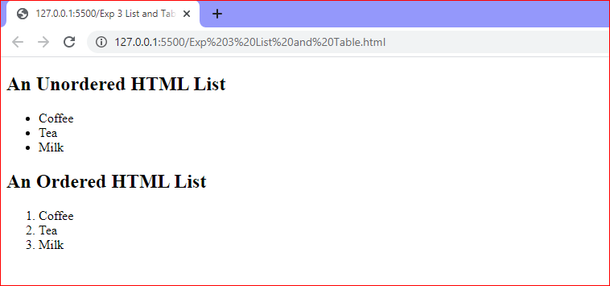

Slide 12
iii) HTML Description Lists
HTML also supports description lists.
A description list is a list of terms, with a description of each term.
The <dl> tag defines the description list, the <dt> tag defines the term (name), and the <dd> tag describes each term:
Example
<dl>
<dt>Coffee</dt>
<dd>- black hot drink</dd>
<dt>Milk</dt>
<dd>- white cold drink</dd>
</dl>

Slide 13
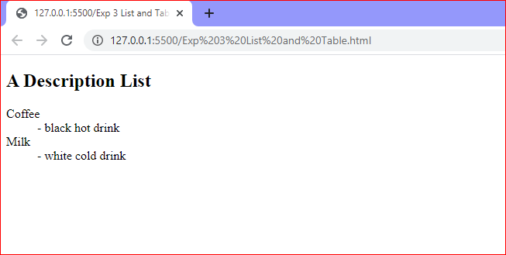

Slide 14
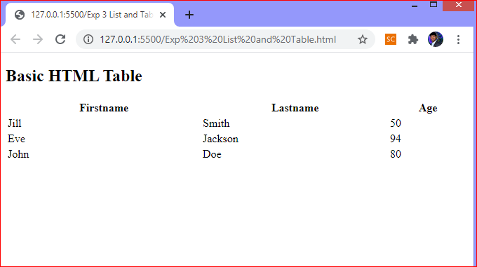
II) HTML Table:

Slide 15
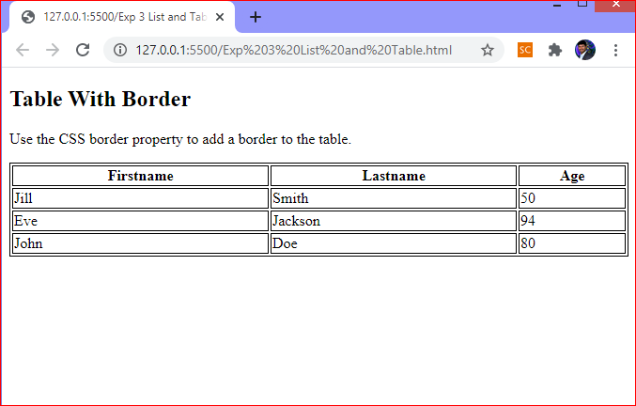
HTML Table - Add a Border:
To add a border to a table, use the CSS border property:
Example
table, th, td {
border: 1px solid black;
}

Slide 16
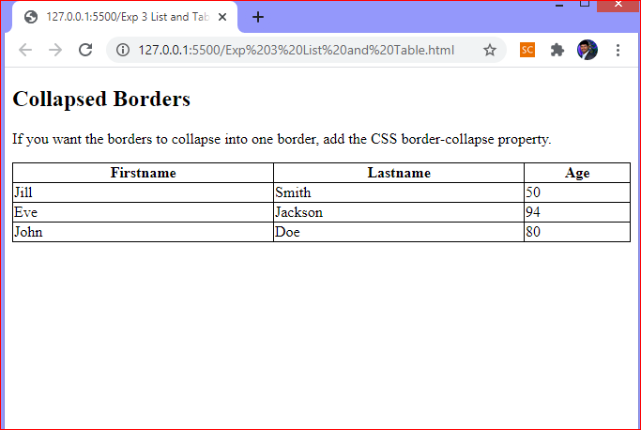
HTML Table - Collapsed Borders:
To let the borders collapse into one border, add the CSS border-collapse property:
Example
table, th, td {
border: 1px solid black;
border-collapse: collapse;
}

Slide 17
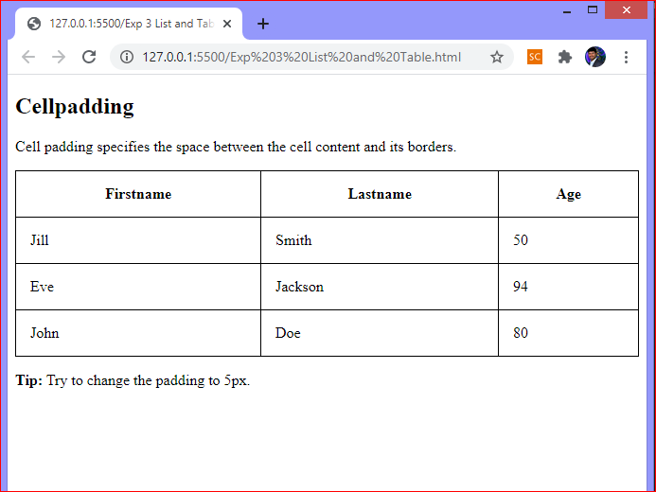
HTML Table - Add Cell Padding:
Cell padding specifies the space between the cell content and its borders.
If you do not specify a padding, the table cells will be displayed without padding.
To set the padding, use the CSS padding property:

Slide 18
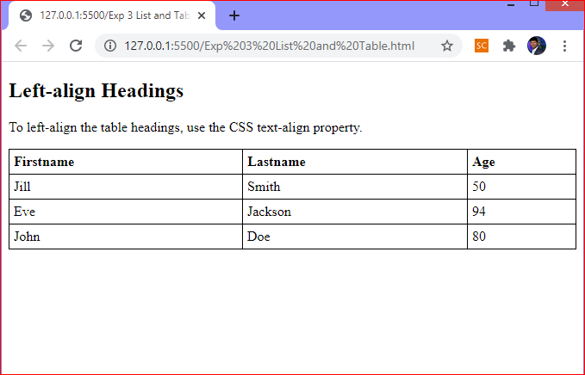
HTML Table - Left-align Headings:
By default, table headings are bold and centered.
To left-align the table headings, use the CSS text-align property:
Example
th {
text-align: left;
}

Slide 19
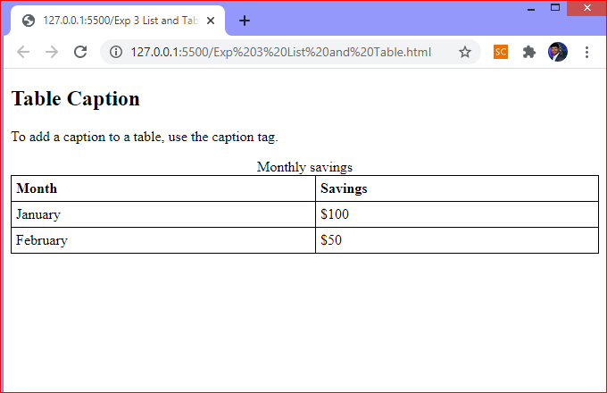
HTML Table - Add a Caption:
To add a caption to a table, use the <caption> tag:

Slide 20
SUMMARY
Understanding about the HTML list and table

Slide 21
SELF-ASSESSMENT QUESTIONS
Mention different types of HTML list
Mention different commands of HTML table.

Slide 22
TERMINAL QUESTIONS
Enlist types of HTML list
2. Enlist different HTML table

Slide 23
THANK YOU

